Slide 1
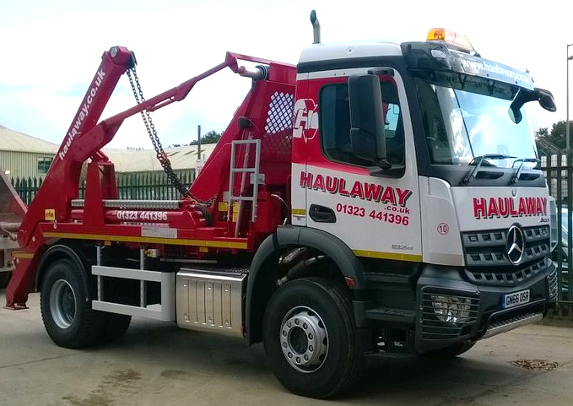
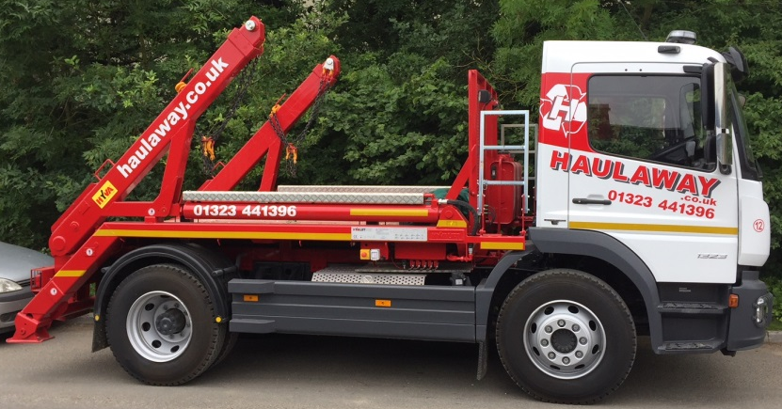
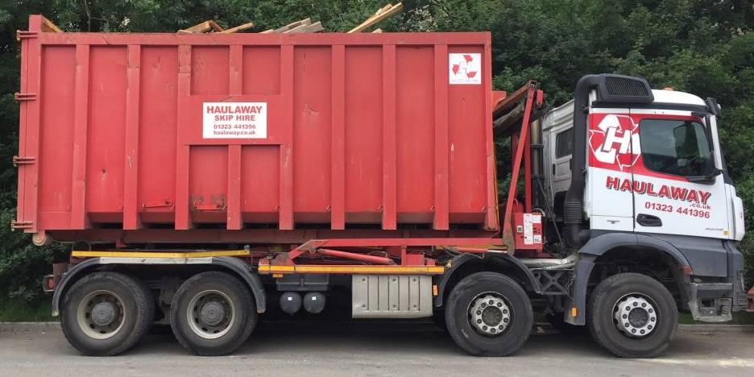
18 ton Skip Lorry
Height – 15.2ft/4.6m
Width – 10.2ft/3.10m
Length – 22.6ft/6.9m
13.5 ton Skip Lorry
Height – 13.1ft/3.9m
Width – 9.5ft/2.3m
Length – 20.7ft/6.3m
32 ton Rolonof Lorry
Height – 14.10ft/4.3m
Width – 10.2ft/3.10m
Length – 30.5ft/9.3m

